Slide 1

Recommendation System based on Adaptive Ontological Graphs and Weighted Ranking
1
Sagar Jauhari
Vikramaditya R. Jakkula

Slide 2
Introduction
What is a Recommendation System?
Query
search
search
search
Recommendation
Characteristic preferences

Slide 3
Introduction
This work proposes a novel method to build a recommendation system based on adaptive ontological graphs with weighted ranking.
Ontological knowledge
Dynamic Ranking
Results

Slide 4
The recommendation process
Query
Recommendation
Relationships
Ontological Graph
Ranking
Weights
Results Output
Updating weights
User selection

Slide 5
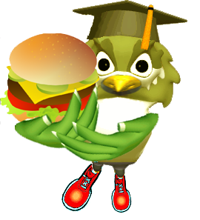

RecipeMiner
The experiment deals with building a recipe recommendation system, called RecipeMiner.
RecipeMiner incorporates all the discussed features like ontological classification and dynamic weighted ranking approach.

Slide 6
Layered approach towards Recommendation
Semantic
Layer
Adaptive
Layer
Result-Set
Ontological knowledge
Dynamic Ranking
Results

Slide 7
Layered approach towards Recommendation
Semantic Layer:
A static classification mechanism for various entities in the pool of objects which can present themselves as the final recommendation to the user.
Dynamic Ranking Layer:
An ordering of the objects derived from the first layer which is dynamic and adaptive to changes in various selection criteria and feedback.

Slide 8
Adaptation and Ranking
Adaptation and ranking are two important aspects of Recommendation Systems.
The system should give recommendation in various scenarios.
The system should dynamically adapt to user choices and preferences.
The system should rank the recommendation results suitably.

Slide 9
Proposed Method
The proposed method consists of two major steps:
Step 1: Building an ontological database
The database for RecipeMiner consisted of more than 1000 recipes and 6 classification categories.
Step 2: Devising an adaptive ranking mechanism
And adaptive ranking algorithm was devised on the basis of clustering techniques.

Slide 10
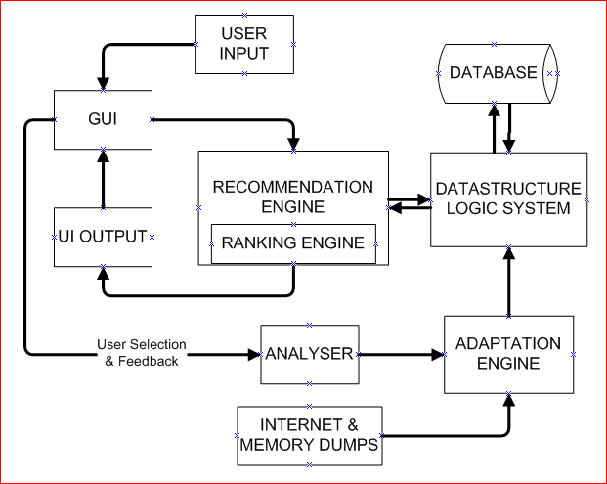
Architecture
The architecture of the proposed recommendation system

Slide 11
Ontological Database
Data sources:
WordNet
WordNet provides the semantic relationship, neighbors, parents and children nodes of a large number of entities
Wikipedia
Wikipedia is an excellent source for extracting ontological information and semantic relatedness between entities

Slide 12
Building the Ontological graph
154
332
992
Lunch
Greek
Dinner
/
Desert
Italian
Chinese
132
220
High Calorie
Low Calorie

Slide 13
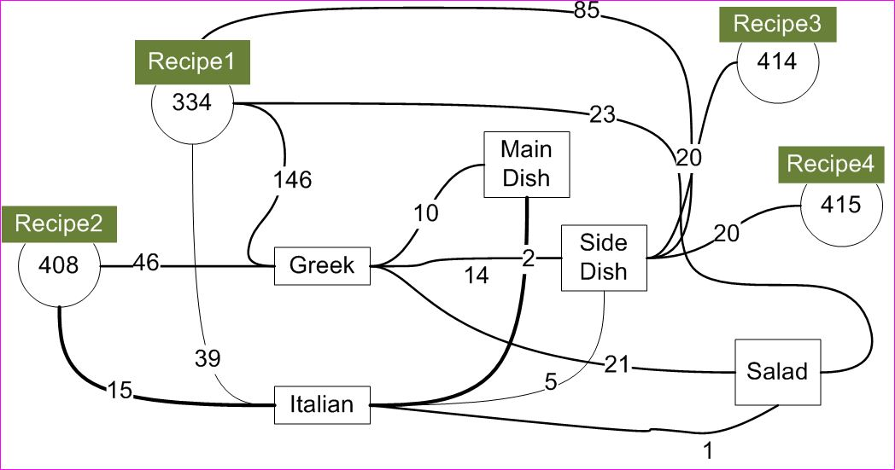
The ontological graph
Connect the various entities based on semantic relationship

Slide 14
Ranking system
After the individual category weights have been clustered (Support Vector Clustering used here), one of the following approaches can be followed:
Cluster-Minimum Method
Cluster-Mean Method

Slide 15
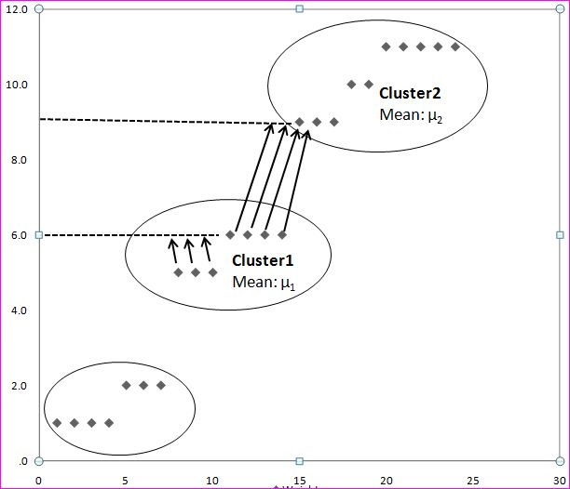
Cluster-Minimum Method
If the entity with positive feedback is the highest weighted entity in its cluster, then increase its weight to the minimum of the next higher cluster. Else, Increase it by one unit.

Slide 16
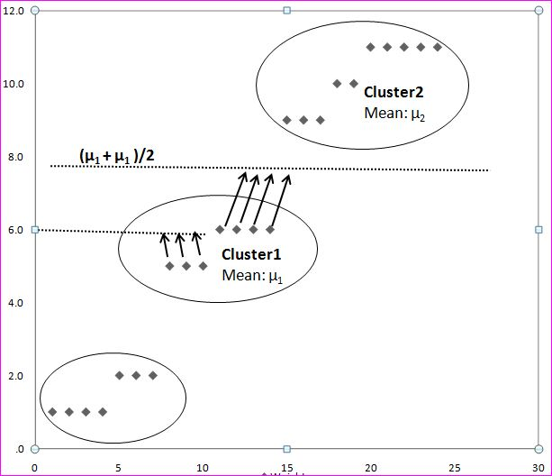
Cluster-Mean Method
If the entity with positive feedback is the highest weighted entity in its cluster, then increase its weight to mean of its own and the next higher cluster. Else, increase it by one unit.

Slide 17
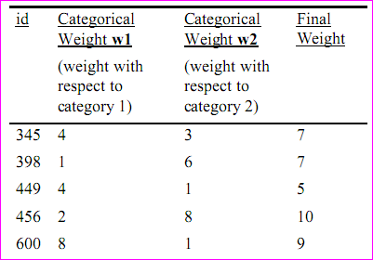
Final weight of an entity
The final weight of a recipe with respect to multiple categories is the summation of the weight of all the selection categories.

Slide 18
RecipeMiner
Steps in Recommendations:
Initialization
Querying the database and recommending
Update system with user feedback

Slide 19
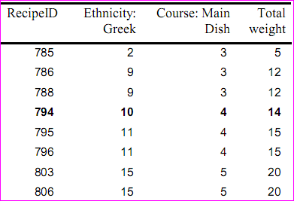
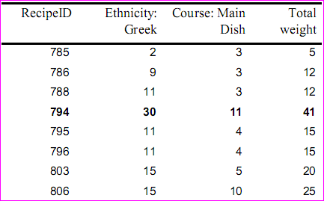
Working of the Ranking System
Change in weights after continuous feedback on recipe with RID=794

Slide 20
Dimensions and Metrics
Top-ten match:
For the same set of selected categories, it was recorded whether the recipe selected by the user was actually in the top ten recommended recipes. A correct match signified that the user selected a recipe from his/her top ten recommendations.

Slide 21
Dimensions and Metrics
Magnitude of error:
This dimension was determined by the difference in the ranks of the topmost predicted recipe and the actual recipe selected by the user.

Slide 22
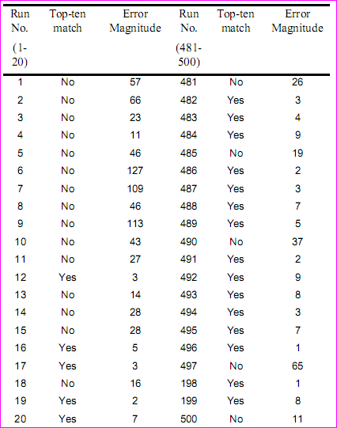


Result discussion

Slide 23
User feedback
Apart from quantitative measures, a feedback questionnaire was prepared to the test the interestingness and the accuracy of the tool. Various questions were asked in both these areas and the following statistic was recorded:

Slide 24
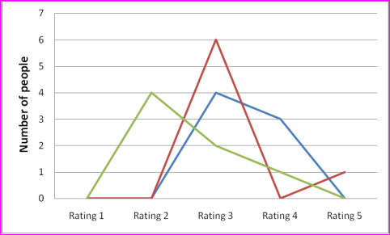
User feedback
User ratings for question pertaining to ‘interestingness’.

Slide 25
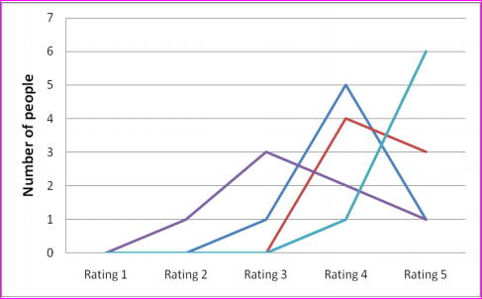
User feedback
User ratings for question pertaining to ‘accuracy’.

Slide 26
Related Work
JaDaCook: Java Application Developed and Cooked Over Ontological Knowledge- P. Javier Herrera, Pablo Iglesias, David Romero, Ignacio Rubio, Belén Díaz-Agudo
A Wine and Food Pairing Recommendation System . Felix Santiago, MIT Open Courseware.

Slide 27
Related Work: Case Based Reasoning
Case-Based Reasoning (CBR) is a successful paradigm of problem solving within Artificial Intelligence. Instead of relying solely on general knowledge of the problem domain, or making associations in the course of relations between descriptions of the problem and conclusions, this paradigm is capable of using specific knowledge of previous experiences (cases).

Slide 28
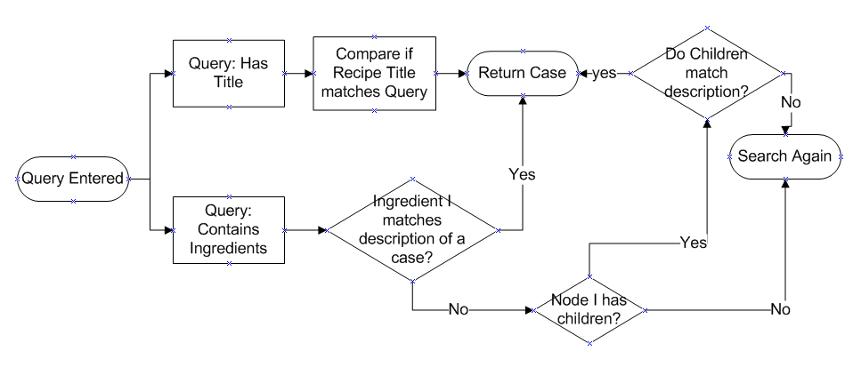
Related Work: Case Based Reasoning
Information Retrieval in Case Based Reasoning approach

Slide 29
Conclusion
Ontological relationships provide wealth of knowledge about an entity’s properties and can be harvested for categorizing generic data.
The user of ontological knowledge for recommendation is a promising approach and can be further enhanced by dynamic ranking mechanisms as discussed in this work.
The groups formed by ontology can be conceptualized at various levels in the form sub-graphs

Slide 30
Thank you!
End

